Slide 1
Ancient Civilizations
Unit 1 Section 2

Slide 2
Defining “Civilization”
Different sources have different definitions of “civilization”, so depending on what website you click on, you may come across different answers for “What was the first civilization?”.
Various answers include: Mesopotamia (a very common answer), Nubia (also a very common answer), and other various ancient civilizations.
For this class, we define civilization as: an advanced level of development in society that is marked by a complex social and political organization, and material, scientific, and artistic progress

Slide 3
In English Please!
In simple English, civilizations earn the title of “civilization” by having:
Social Organization
Political Organization
Material Progress
Scientific Progress
Artistic Progress
Can you give me an example of each?

Slide 4
The Ancient Civilizations
Nubia
Kemet
Kush

Slide 5
Nubia
Nubia is approximately 1,118.5 miles long
It runs along the fertile banks of the Nile River, from Khartoum, Sudan, to Aswan, Egypt.

Slide 7
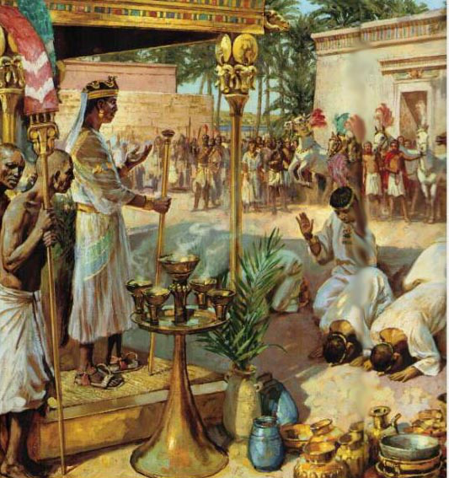
Nubia Civilization
What did they eat?
They grew cassava, rice, and bananas.
They established farms, planted fruit trees, and fished.

Slide 8
Nubia as Master Builders
The Nubians were master builders
They developed the technique of building houses out of mud brick.
Why did they do this?
Mud brick was cool during the hot sun of the day, and warm during the cool of the night.

Slide 9
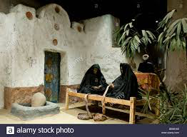
Mud Brick Houses

Slide 10
Nubia as Master Builders
Nubians also constructed tool-making sites, shrines, and temples where they preformed religious ceremonies.
The Nubians also designed and made weapons of war, as well as pottery and baskets.
These things were accomplished long before they spread to Kemet.

Slide 12
Nubia Government
Nubians were the earliest humans to develop the concept of monarchy. What is a monarchy?
Monarchy is a form of government headed by a supreme ruler such as a king or queen.
1967 - Archeologists discovered relics with an image of a crown and symbols of kingship.
These relics existed long before similar images appeared in Kemet.
The idea of divine kingship is believed to have originated with the Nubians Africans in the 4th millennium BC.

Slide 13
Kemet
Kemet stretched along the Nile River from what is present day Aswan north to the Mediterranean Sea and lasted from 3400 BC to the conquest of Alexander the Great in 332 BC.
The land of Kemet was the home of the most majestic civilizations of antiquity.
The people of Kemet called the Nile River “Hapi”. The Nile River gave life to everything that grew on its banks. Without it, Kemet would have never existed.

Slide 15
How Kemet Came To Be
So how did the Kemet civilization form?
Well, originally Kemet was a bunch of individual groups, but when the Nile annually flooded, the groups all came together to manage the overflowing of the Nile and in the process developed a great civilization.

Slide 16
Flooding Is A Good Thing
The flooding wasn’t all bad. In what way could it be a good thing?
Well, the annual flooding would bring deposits of fertile soil from the interior of Africa to the Nile Valley.
It gave us geometry.
It gave us a calendar.
It gave us easy transportation of heavy materials.

Slide 17
Fertile Deposits
The fertile soil deposits the flooding brought were crucial for agriculture.
Agriculture was crucial for survival and population increase.
The population increase was (and always is) one of the many reasons for the creation of a civilization.

Slide 18
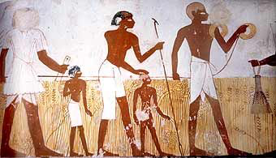
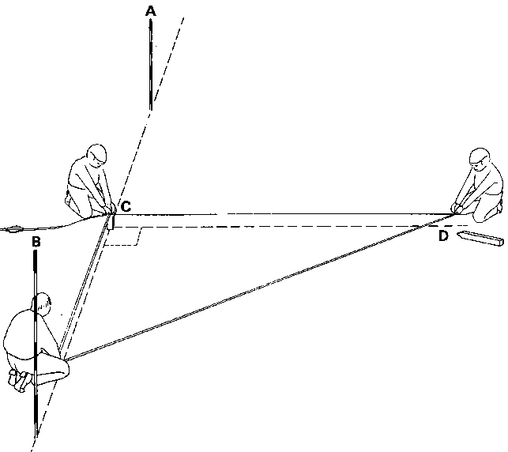
Geometry
So the flooding would often destroy property boundaries.
The Kemet would use ropes to measure out the proper amounts of land so the boundaries could be rebuilt.
Notes:
So much like we have our modern day surveyors, they laid out rope to mark boundaries.

Slide 19
The First Calendar
The people of Kemet coordinated the rising of Sirius, the brightest star in the heavens, with the inundation.
What do you think inundation means?
Inundation is another word for the annual flooding of the Nile.
From these two data points, they created the world’s first calendar.

Slide 20
Easy Transport
During the floods, the Nile was an important means of transportation for moving heavy building materials downstream.
The people of Kemet used it to transport timber and large stones for shipbuilding and massive building projects.

Slide 21
Hard Work and Dedication
It rarely rained in Kemet. The sun was a constant reminder of stability and regularity.
They followed the sun’s example; the people used their time productively in agriculture and building.
Even during the flooding, they just moved to higher ground and continued to work.
Some historians have suggested that this stability was a sort of stagnation which may have slowed their progress. What do you think? Do you agree/disagree? Explain your reasoning.

Slide 22
An important part of civilization was…..
GOVERNMENT!
GOVERNMENT!

Slide 23
Kemet Government
Kemet developed into a unique civilization with a centralized government.
This government united 42 different cities, called Nomes, along the Nile.
This union was all thanks to a guy named Menes. (He is sometimes called Narmer)
He was the king of the 1st Dynasty, and he united the various groups of Upper Kemet to the south with the groups of Lower Kemet to the north into one nation.

Slide 24
Vocab Check!
What is a Dynasty?
A Dynasty is a family of kings and queens which rules for a long period of time.

Slide 25
Menes’ Accomplishment
Before Menes united the groups, there were just groupings of clans along the river.
His unification in 3200 BC marked the first time in recorded history that a ruler brought together so many different groups into a single nation.
This accomplishment earned him the title “Father of the Nation”.

Slide 26
Imhotep
He was a prime minister during the 3rd Dynasty, and he was somewhat of a celebrity.
You see, he is the first personality in recorded history about whom so much is known!
There are written records about many aspects of his life, including his career, his parents, and even what he believed and thought on certain issues.
He lived about 2700BC. In addition to his job as prime minister, he was an architect, a physician, a philosopher, a scribe, and a historian.

Slide 27
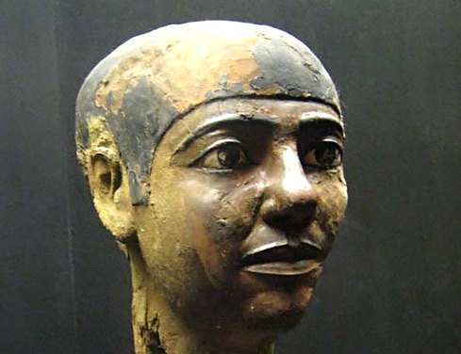
Imhotep was so great that later generations worshipped him as a god.
His name comes from the ancient Kemetic language: Medu Neter (MEH-doo NAY-tur).
The root word hotep means “peace”, thus his name means “he who comes in peace”.

Slide 28
Four Major Periods
Of Kemet History

Slide 29
The Four Periods
So Kemetic history is usually divided into four major periods which roughly correspond to periods of stability separated by four periods of disorganization and internal warfare.
These periods are:
The Thinite Period (3150 BC – 2700 BC)
The Old Kingdom (2700 BC – 2190 BC)
The Middle Kingdom (2000 BC – 1786 BC)
The New Kingdom (1580 BC – 1069 BC)

Slide 30
The Thinite Period 3150 BC – 2700 BC
The Thinite Period was a period of major achievements in construction and exploration.
Imhotep built the first pyramid for King Djoser. (JOS-sahr)
It was called the Sakkara Step Pyramid because it was constructed to look like giant steps.
Its complex contains the oldest masonry building in the world.
The Great Pyramids of Giza were created in Imhotep’s example.

Slide 31
The Old Kingdom 2700 BC – 2190 BC
During the Old Kingdom, trade between Kemet and sub-Saharan Africa flourished.
In addition to trade, the Old Kingdom saw cultural exchange. A governor of Aswan named Harkuf (har-CUFF) went on three expeditions to the interior of Africa about 2130 BC to places that appear to be in the Congo Basin.
He and his caravan traveled more than 1000 miles across the Sahara Desert to the Ituri (i-TUR-ee) rain forest in Central Africa, where he visited the Twa (TWAH) people.
(cont)

Slide 32
The Old Kingdom 2700 BC – 2190 BC
In one of his diaries Harkuf declared, “I have come here from my city, I have descended from my name, I have built a house, set up its doors, I have dug a pool, planted sycamores, The king praised me, My father made a will for me. I was one worthy.”

Slide 33
The Old Kingdom 2700 BC – 2190 BC
He was also a skilled diplomat and negotiator who knew how to conduct himself as he traveled from nation to nation.
On his third exploration he visited the kingdom of Yam, which was located either in the central or southern part of contemporary Sudan.
He received many gifts there. Others had gone to Yam before, but had little to no success.
When the ruler of Irtjet (ert-JET) saw the gifts from the king of Yam that Harkuf had brought with him, he allowed Harkuf to pass through the country of Irtjet.

Slide 34
Why did I spend so much time talking about Harkuf?
Why might what he and his accomplishments be significant?
Notes:
DIPLOMACY!!!!!!!!!
Nations/Civilizations interacting, trading – modern relationship developed

Slide 35
The Middle Kingdom 2000 BC- 1786 BC
The Middle Period came into existence following the first intermediate period of warfare between the people of Kemet.
The country was led out of confusion and internal strife by kings from Upper Kemet about 2000 BC.
A dynasty, led by Mentuhotep I (men-too-HOH-tep) came to power and restored the temples, built palaces, improved administration of the agricultural lands, and established military supremacy over Kemet’s neighbors to the north and south.

Slide 36
The Middle Kingdom 2000 BC- 1786 BC
The Middle Kingdom was a period of great conquest under kings such as Senusert 1 and Senusert II who conquered much of the known world including Syria and regions around the Black Sea in southwestern Asia.
Unfortunately, the Middle Kingdom grew weak from internal divisions and the growing presence of Asians in the Nile Delta region in Lower Kemet, it lost control over the entire country.

Slide 37
The New Kingdom 1580 BC – 1069 BC
During this time, Kemetic rulers from Upper Kemet reasserted the power of the central government and reunited the main centers of Kemetic authority, such as the temples at Heliopolis, Memphis, Abydos, and Thebes. This reunited area stretches from Cairo to Luxor in modern Egypt.
The first king of this reunited “18th Dynasty” was Ahmose (ah-MOSE). He succeeded in driving the Hykosos from Kemet and established the first dynasty of the New Kingdom.
The reason why this is important is because after this, there are no more fabled dynasties existing in Kemet’s history.

Slide 38
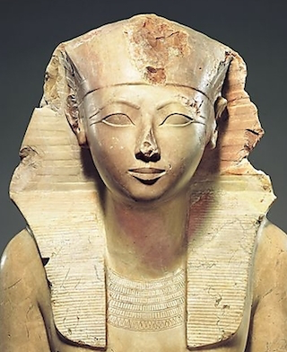
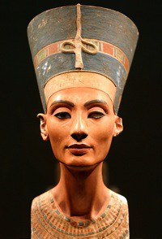
Move Over Boys, The Queen’s Coming Through!
The New Kingdom was also the age of Hatshepsut (hat-SHEP-sut) (1503 BC – 1482 BC).
Who was Hatshepsut?
She was Kemet’s first recorded female pharaoh. She ruled her nation in her own right as leader of a great empire.

Slide 39
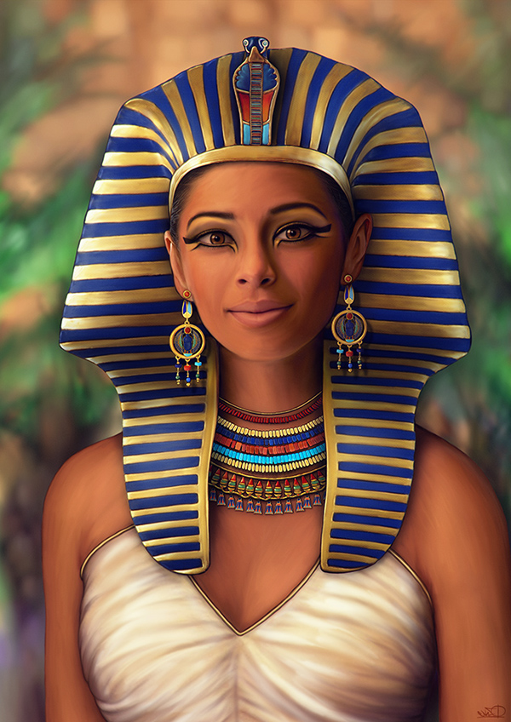

Slide 40
Tutankhamen
You may know of this boy king, for he is rather famous.
He lived approximately 1361 BC – 1352 BC (18 when he died).
Because he died at such young age, he didn’t make any memorable achievements as king.
However, he is still super important to us. Can you guess why?

Slide 41
Tutankhamen
So unfortunately many of the tombs of the New Kingdom were broken into by tomb-raiders. Precious artifacts, mummies, and other items of interest were lost to us forever.
However, King Tut was buried under the tomb of Ramses VI. I guess death didn’t agree with Ramses because his tomb collapsed, burying King Tut’s tomb under rubble.
It is thanks to this event that King Tut’s tomb remained untouched by the raiders.
King Tut owes his place in history to the remarkable artifacts that were found in his tomb and recovered for future generations.

Slide 42
The Legacy of Kemet
Kemet lasted for 11 Dynasties after King Tut, before its glory faded.
Other states in Africa were ready to take their walk in the bright sunlight of history.

Slide 43
Kush
The Jewel of Nubia
800 BC – 300 BC

Slide 44
Kush
Kush was a kingdom located in the territory called Nubia.
Kush was in the area that reached north from present-day Khartoum in Sudan Aswan in Egypt.
By 9th century BC Kush was producing art.
Its people where also demonstrating considerable skill in the production of grain and the distribution of the spoils of war.
During this period in Kush, religious construction flourished, particularly in the building of huge temples to honor the gods and goddesses of the land.

Slide 45
Kush
During its more than thousand years of existence, Kush had 67 kings or queens, from King Kashta in 760 BC to King Malequerebar (mahl-lah-QUER-ree-bar) in 320 AD.
The great civilization of Kush placed remarkable emphasis on revitalizing the Nile Valley.
The kings and queens built numerous shrines and restored monuments form Napata to Memphis, an area covering more than a thousand miles.

Slide 46
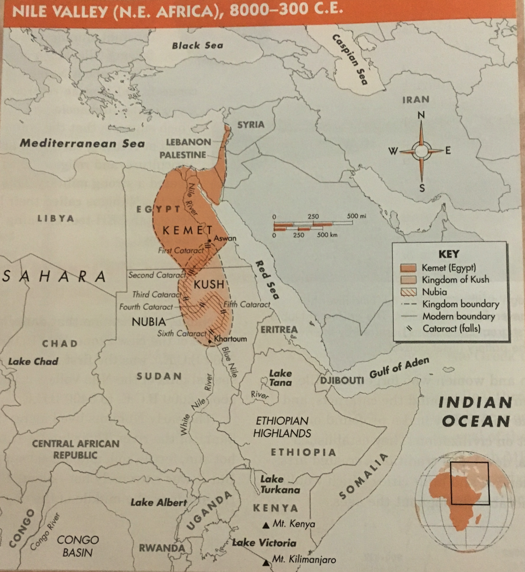

Slide 47
War
When Kemet grew weak from internal struggles for power among its ruling families, the kingdom of Kush, under the leadership of King Kashta, led an invasion into Kemet in 750 BC.
The ease with which Kashta defeated the people of Kemet suggests the weakness of Kemet’s southern borders. Neither the cataracts nor the desert could prevent the military might of the Kushites from advancing northward.

Slide 48
Pharoh Kashta
Kashta took the title of Pharoh of Upper and Lower Kemet and made Napata, his capital city, the first city of the realm.
Residents of Thebes, which had been capital for several centuries, paid homage to Napata in Kush.

Slide 49
Piankhi
By 728 BC, Piankhi (pee-ahn-KEY), Kashta’s son and successor, mounted a second attack on Kemet.
He so utterly defeated the Kemetians, the cousins of the Kushites, that after his conquest he ended the bitter rivalries of the northern families, crushed the Libyan invaders of Kemet, built fortresses, modernized the temples, and repaired the public buildings.

Slide 50
Piankhi Continues
Piankhi ruled Thebes, itself, as the first king of the 25th Dynasty. His conquest of Kemet was more direct and aggressive than his father’s.
After 20 years as ruler of Napata, Piankhi led an army toward Thebes. He marched toward the city because he heard of the movement of a young prince named Tefnakhte (tef-NOT-tee) who was threatening Upper Kemet form his base in Lower Kemet.

Slide 51
Ending His Story
Once in Thebes, Piankhi showed his devotion to Amen, the great god of the city, and reasserted Kushitic rule over Upper Kemet.
He conquered rebellious princes and rulers and consolidated Kushitic power over the entire valley.
Piankhi’s brother, Shabaka (shah-BAH-kah), succeeded him in 716 BC. Piankhhi’s sons, Shabataka (shah-bah-TAH-kah) and Taharka (ta-HAHR-kuh), succeeded their uncle, Shabaka.

Slide 52
Taharka
Taharka was the greatest of all Kushitic kings.
He became ruler in 690 BC and spent much of his time in Kemet. Although Taharka restored monuments, reclaimed wastelands and made them profitable, organized the priesthood to be more effective in aiding the sick, and built obelisks and new temples, his rule was plagued by the Assyrians, an Asian people from an area in present-day Iraq.

Slide 53
The Assyrians
The Assyrians seemed eager to invade the empire.
In 671 BC, they sacked the city of Memphis.
Taharka fled, leaving his wife and young son. He later died, and his nephew took over.
It was during his nephew’s rule that the Assyrians finally succeeded in defeating Kemet.
The Assyrians could not hold Kemet, but they did manage to end the nearly 100 year rule of Kush.

Slide 54
The End of an Era
In 332 BC , a great warrior named Alexander of Macedonia would conquer Kemet and forever end the power of the African rulers.
Miriam Maat Ka Re Monges, a scholar of ancient Kush, argues that most people fail to give Kush the credit it deserves for bringing Kemet into its last Golden Age.
Notes:
So the Assyrians lost control when Persia (present day Iran) invaded Kemet.

